Slide 1
TimSort Algorithm
Prepared by:
Yara Harb - 202001058
Mohamad Khalifeh - 202000865
Ali Youssef Solh - 202004405
Rani Salman - 202001002

Slide 2
TimSort Algorithm
Timsort is a hybrid stable sorting algorithm, derived from merge sort and insertion sort, designed to perform well on many kinds of real-world data. It was implemented by Tim Peters in 2002 for use in the Python programming language.

Slide 3
Sequential Strategy of Timsort
In the sequential solution, we followed the divide and conquer strategy, where divide the array into 2 parts (left and right) until we reach the threshold that we define at the beginning. As long as the array size after dividing is smaller the threshold, we apply insertion sort on the array. However, once the array size after dividing is greater than the threshold, we apply merge sort where we merge the two sorted arrays from the insertion sort and then after merging the numbers are resorted within the same array.
Although there isn’t one clear best sequential solution for sorting arrays, TimSort is a very good algorithm and performs well in practice. We will look to improve the performance of the algorithm with a parallel version.

Slide 4
Parallel solution using Open MPI
In the parallel solution using only Open MPI, we followed the divide and conquer tree form. We generated random numbers and filled the array in process 0. Then, as long as we have processes and the array size is less then the threshold, we send the array size and the data of the array to the left and right children of the processes. The left child will have size of array_size/2 and the right will have the rest of the array with the remainder if any. The left and right child will then receive the two arrays into two new arrays in order to merge them in to one sorted array.
In case a process has only a left child, the process will divide its array into two parts and the process will take half and the left child will take the remaining part of the array. When we don’t have enough process or the array size is greater than the threshold, we apply the TimSort.

Slide 5
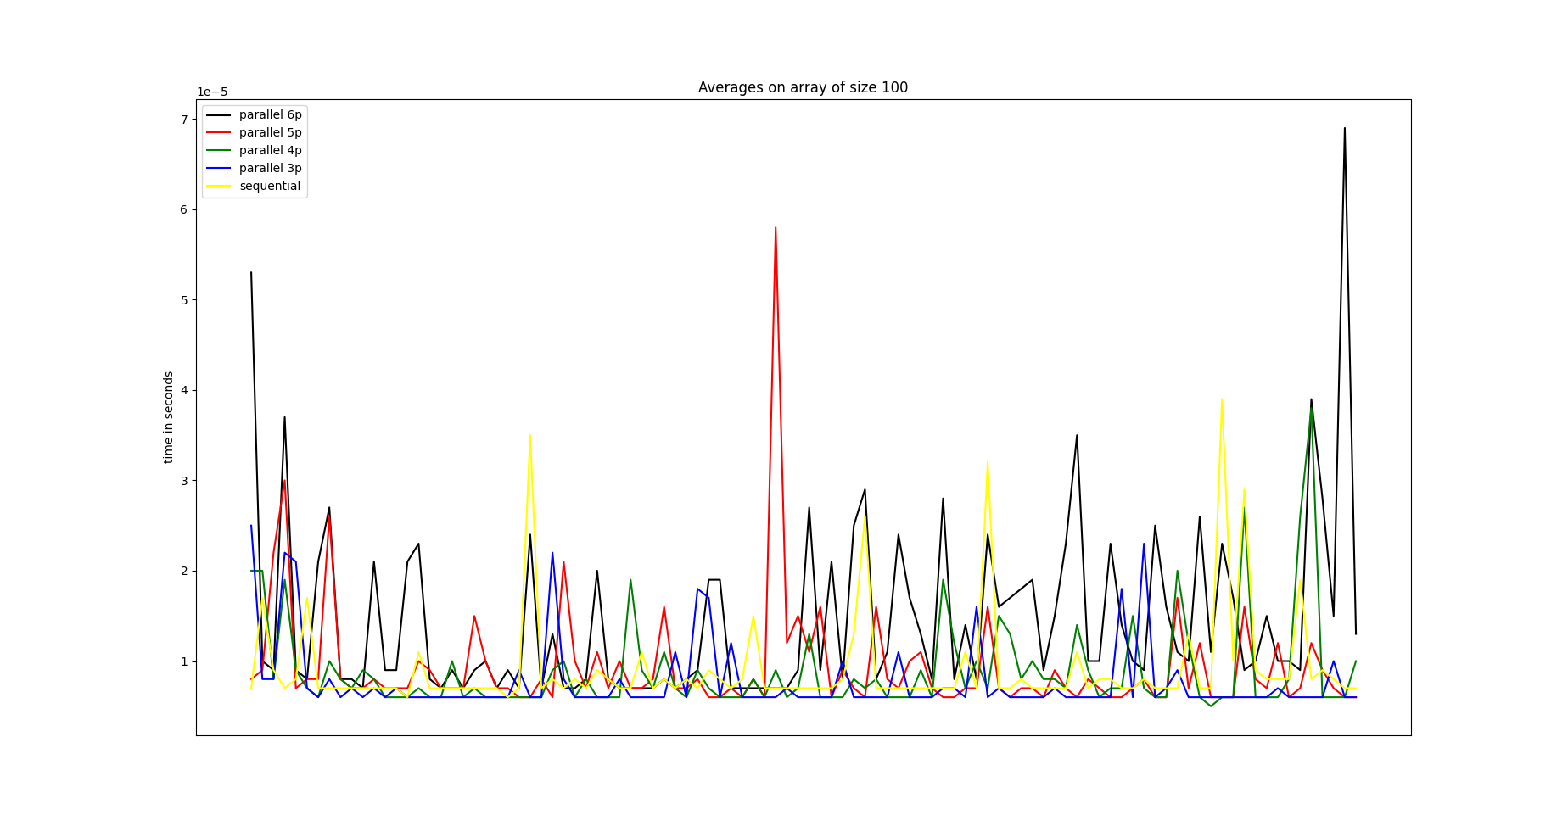

Slide 6
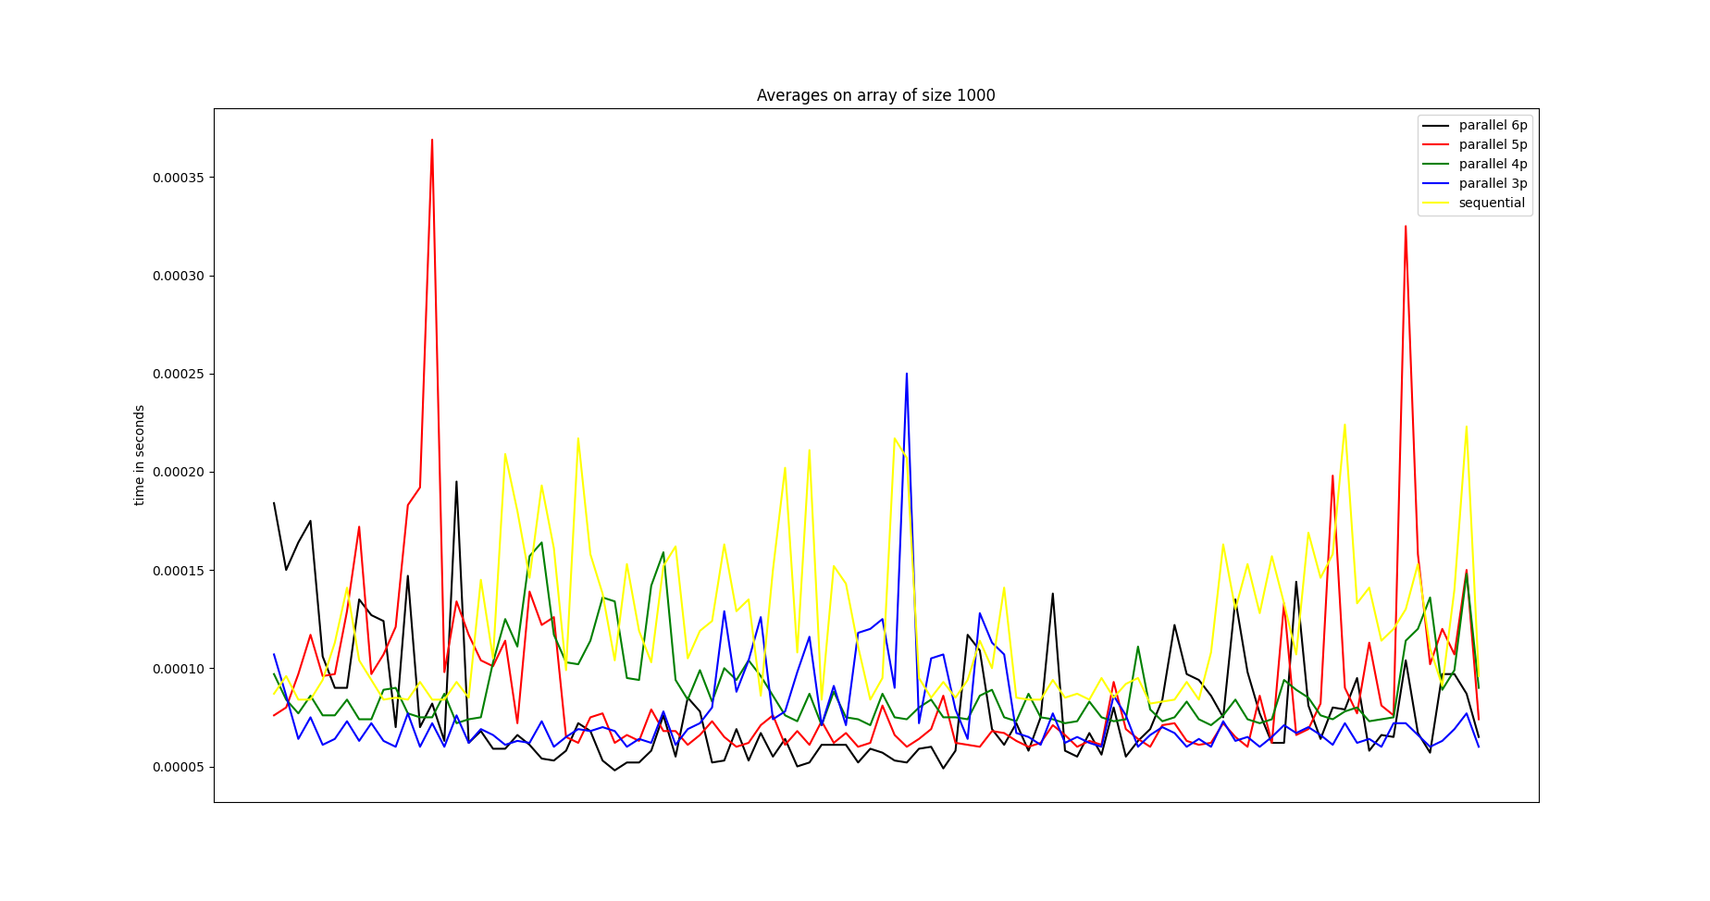

Slide 7
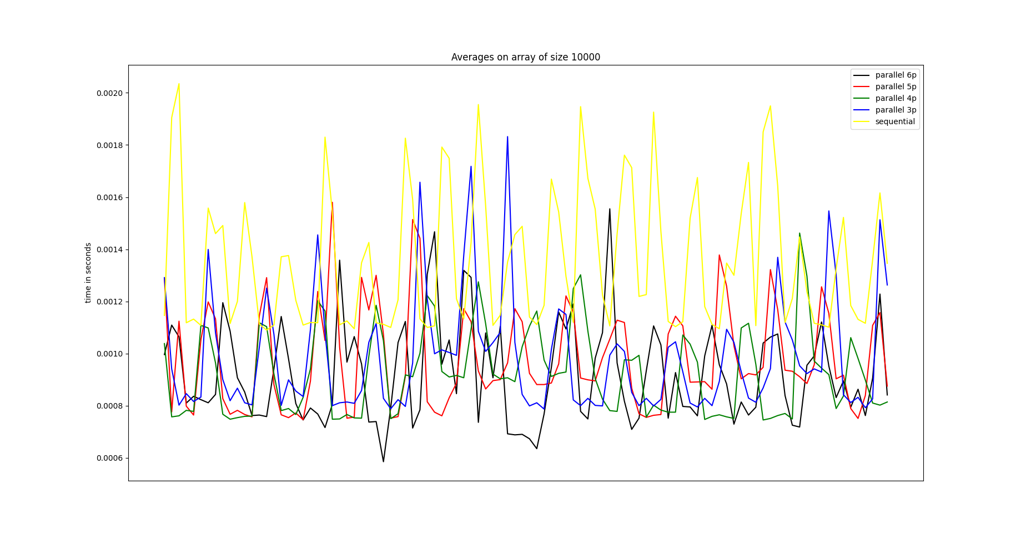

Slide 8
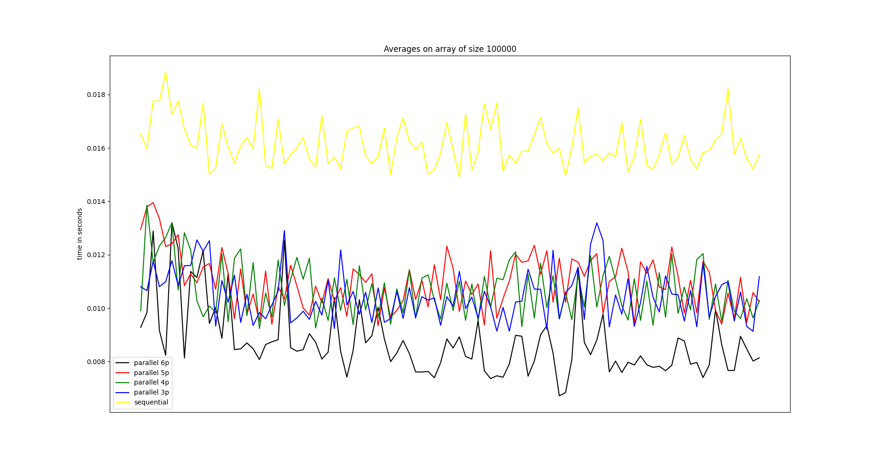

Slide 9
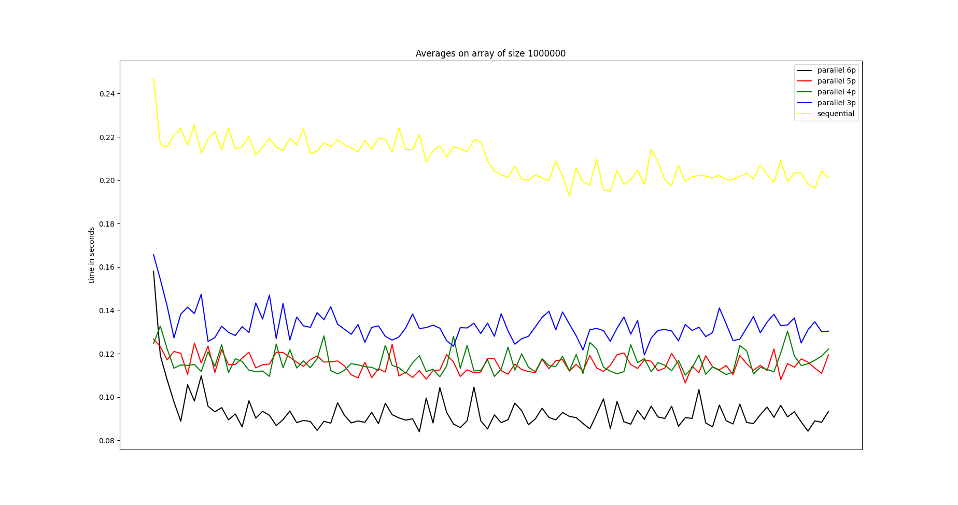

Slide 10
Conclusion of Parallelism
Through the results that we obtained, we can deduce that as we increase the array size and as we increase the number of processes, it becomes more clear that the parallel strategy was faster then the sequential strategy.

Slide 11
Parallel solution using open mpi and threads
In this solution two versions we developed.
In the first version, as mentioned earlier, when there is no processes available anymore, the children of the last process will not only be the ones working on the array, there will be two threads working in parallel on the array each taking half of the array. The threads will call TimSort method and then we join the two threads together.
In the second version, when we reach the leaf process, threads will be created while the divided array is greater than the threshold. The thread as before will call the TimSort method and then we join the two threads together..

Slide 12
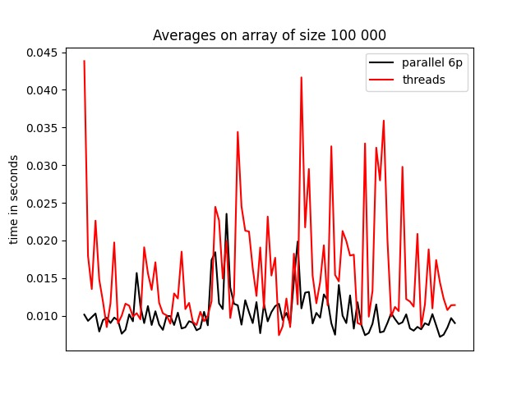
Version 1of Threads

Slide 13
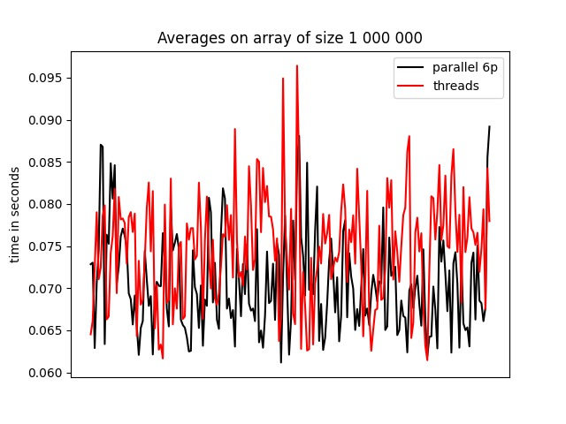

Slide 14
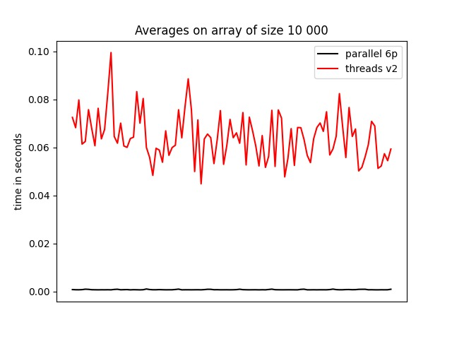
Version 2 1of Threads

Slide 15
Conclusion of threads
Through the results that we obtained, we can deduce that in the first version of threads, it was almost same speed parallel only, so the overhead from creating threads negated the speed up in the parallelization. However, in the second version, where many threads where created, it was super slow due to the overhead of creating a lot of threads.
We also concluded that decreasing the array size is not worth creating threads as it will slow the process. But, in the very large array size arrays it would be efficient to create threads.

